Slide 1
IGCSE World History
Honors Program

Slide 2
How do I gain honors credit?
#1: You can gain honors credit by scoring a C or higher on your IGCSE Cambridge exam at the end of the year!
  Why this is good: If you study hard to get a C (which means you are college-ready!) it not only gives you honors credit but also helps you on your way to the Grand Canyon diploma.
  Why this is tough: Not only is scoring a C difficult on the Cambridge exam, but the results won’t be in until the beginning of your sophomore year. This means you won’t know if you’ve gotten your honors credit until after the class is long over!
#2: You can participate in National History Day!
  National History Day is a competition that you can compete in to gain your honors credit. I do not require you to place in the competition but I do require full participation! If you create a project for this, you will be able to go with us to the regional competition in the spring!

Slide 3
What is National History Day?
National History Day is a year-long academic program focused on historical research, interpretation and creative expression for 6th- to 12th-grade students. By participating in NHD, students become writers, filmmakers, web designers, playwrights and artists as they create unique contemporary expressions of history. The experience culminates in a series of contests at the local and affiliate levels and an annual national competition in the nation's capital in June.
An independent study from 2011 found that participation in the National History Day Contest benefits students far beyond the competition. National History Day not only transports classrooms back in time during the school year, it transforms young minds forever.
www.nhd.org/why-nhd-works

Slide 4

NATIONAL HISTORY DAY 2019
The theme of NHD 2019 is “Triumph and Tragedy in History
You may choose any World History topic that fits within this theme. Some examples might be: The Six-Day War, Joseph Stalin and the Purge of Russia, Treaty of Versailles: Triumph or Tragedy?, Neville Chamberlain: The Tragedy of Appeasement, or any other topic that you would be interested in doing that fit the theme.

Slide 5
How to create a project
Documentary
Must work alone
Must be original
Exhibit
Work alone or in group no larger than 5
Paper
Performance
Work alone or in group no larger than five
Include lots of phots and film clips
Include music and student narration
Shown by student at contest
Include free-standing display
Include lots of primary source photos
Include student-composed analysis
Displayed by student at contest
Must work alone
Write traditional or creative paper
Rely on words to tell story
Must utilize strong writing skills
Submitted prior to contest
Must be a dramatic performance, not an oral report
Write an original script
Include student created costumes and set
Performed live at contest
Website
Work alone or in group no larger than five
Must be a collection of webpages
Include original photos, maps, music, etc.
Incorporate interactive multimedia
Submitted prior to contest

Slide 6
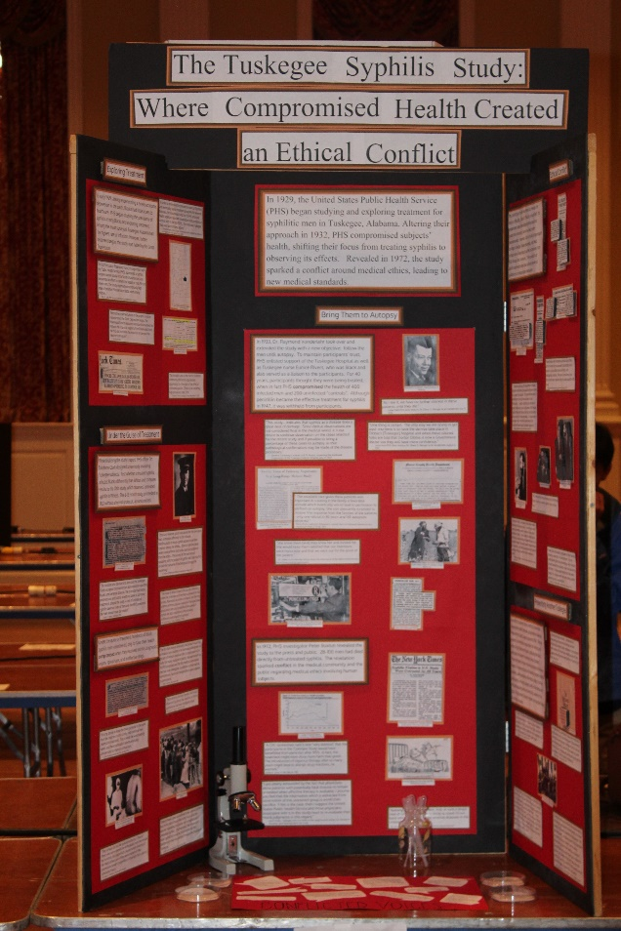
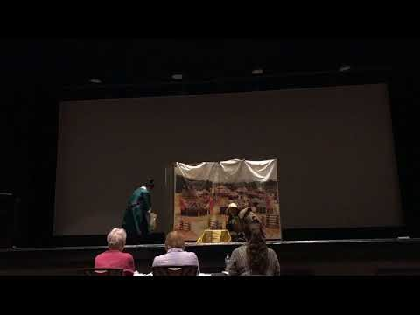
What should my project look like?
Exhibit
Website
http://34444118.weebly.com/
Performance

Slide 7
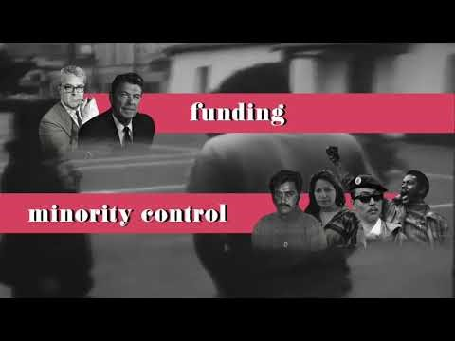
What should my project look like?
Paper
Documentary
“The Conflict of Conservation, Fashion, and Industry: Compromise between Environmentalists, Women and the Plume Trade” by Tammy Zhang
Written Materials

